Slide 1
CS378 - Mobile Computing
Anatomy of and Android App and the App Lifecycle

Slide 2
Application Components
four primary components
different purposes and different lifecycles
Activity
single screen with a user interface, app may have several activities, subclass of Activity
Most of early examples will be activities
Service
Application component that performs long-running operations in background with no UI
example, an application that automatically responds to texts when driving

Slide 3
Application Components
Content Providers
a bridge between applications to share data
for example the devices contacts information
we tend to use these, but not create new ones
Broadcast Receivers
component that responds to system wide announcements
battery low, screen off, date changed
also possible to initiate broadcasts from within an application

Slide 4

Hello Android
Create an Activity
Demonstrate resources created
show the Activity lifecycle within the Android OS
show the various debugging tools available
show how to start one Activity from another

Slide 5
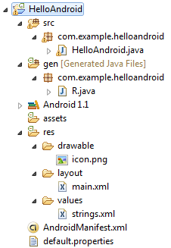
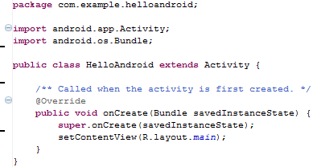
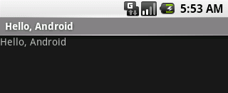
Hello Android Tutorial
http://developer.android.com/resources/tutorials/hello-world.html

Slide 6
Important Files
src/HelloAndroid.java
Activity which is started when app executes
res/layout/main.xml
Defines & lays out widgets for the activity
res/values/strings.xml
String constants used by app
gen/R.java (DO NOT MODIFY!)
Auto-generated, auto-updated file with identifiers from main.xml, strings.xml, and elsewhere
AndroidManifest.xml
Declares all the app’s components
Names libraries app needs to be linked against
Identifies permissions the app expects to be granted

Slide 7
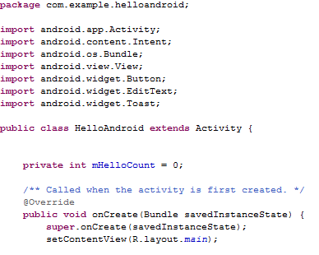
src/HelloAndroid.java
Activity which is started when app executes

Slide 8
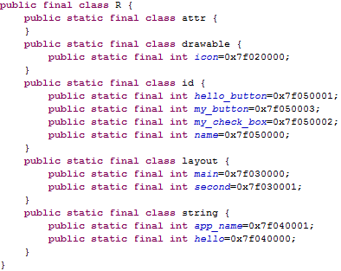
gen/R.java
Auto-generated file with identifiers from main.xml, strings.xml, and elsewhere
Do not modify!

Slide 9
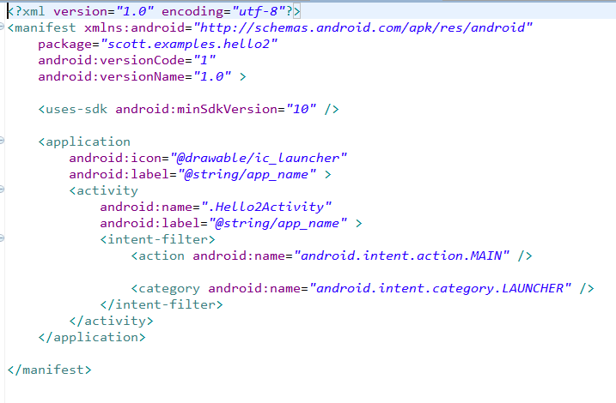
AndroidManifest.xml
Declares all the app’s components
Names libraries app needs to be linked against
Identifies permissions the app expects to be granted
min sdk version
Notes:
This is the most common IntentFilter seen in Android applications. The action android.intent.action.MAIN indicates that this is the first activity that should be executed when starting this app. The category android.intent.category.LAUNCHER places this Activity in
the launcher window (the window that lists all the available apps).

Slide 10
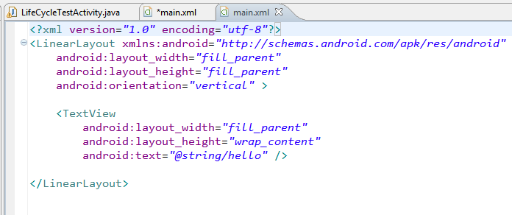
res/layout/main.xml
layout of main activity
xml view

Slide 11
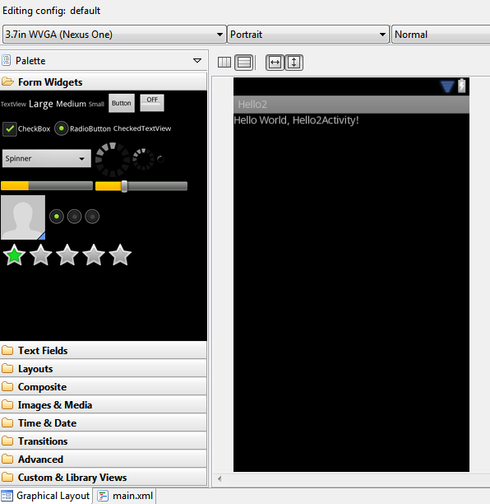
res/layout/main.xml
Drag and Drop UI Editor (your mileage may vary.)

Slide 12
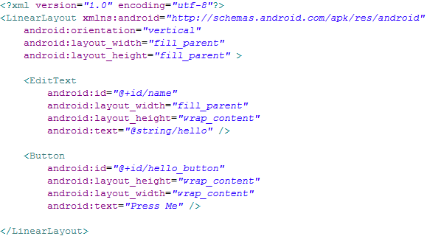
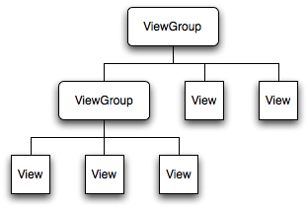
res/layout/main.xml
Declares layouts & widgets for the activity
Tree from: http://developer.android.com/guide/topics/ui/index.html
Notes:
A ViewGroup is a special view that can contain other views (called children.) The view group is the base class for layouts and views containers. The ViewGroup subclass is the base class for layouts, which are invisible containers that hold other Views (or other ViewGroups) and define their layout properties. LinearLayout is a subclass of ViewGroup.
The View class represents the basic building block for user interface components. A View occupies a rectangular area on the screen and is responsible for drawing and event handling. View is the base class for widgets, which are used to create interactive UI components (buttons, text fields, etc.).

Slide 13
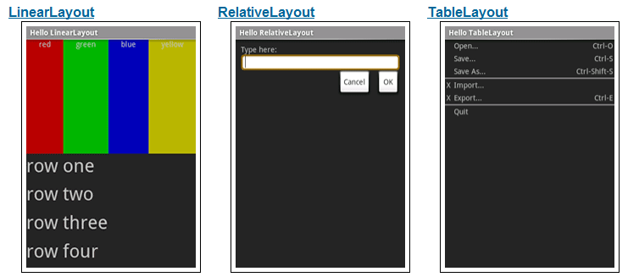
Available Layouts
http://developer.android.com/resources/tutorials/views/index.html

Slide 14
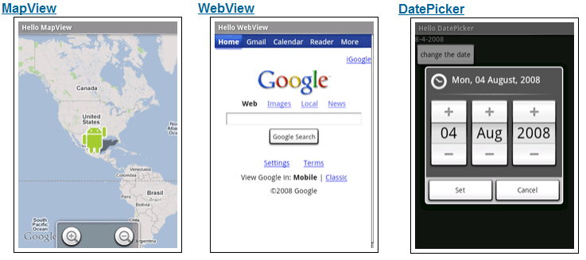
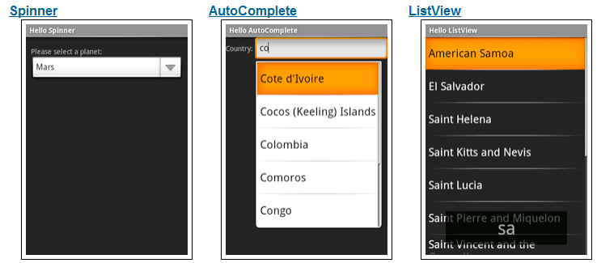
Available Widgets
http://developer.android.com/resources/tutorials/views/index.html

Slide 15

res/values/strings.xml
String constants used by app
Used for supporting Localization
res/values-es/values/strings.xml to support Spanish
res/values-fr/values/strings.xml to support French
Etc.

Slide 16
Activity Stack
Most recently created is at Top
Activity 1
User currently interacting with me
Activity 2
Pressing Back or destroying A1 will bring me to the top
Activity 3
Activity N
If Activities above me use too many resources, I’ll be destroyed!

Slide 17
Typical Game
High Scores
Activity
Splash Screen
Activity
Main Menu
Activity
Game Play
Activity
Settings
Activity
Conder & Darcey (2010), Fig 4.1, p. 74

Slide 18
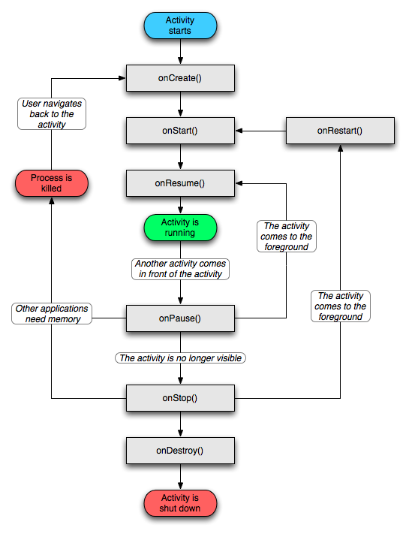
Activity Lifecycle
http://developer.android.com/reference/android/app/Activity.html

Slide 19
Starting Activities
Android applications don't start with a call to main(String[])
instead a series of callback methods are invoked
each corresponds to specific stage of the Activity / application lifecycle
callback methods also used to tear down Activity / application

Slide 20
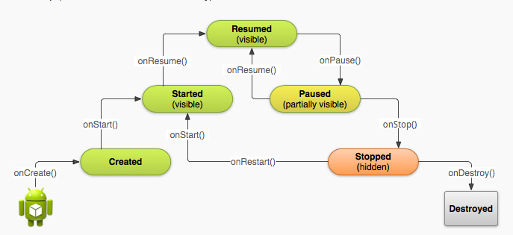
Simplified Lifecycle Diagram
ready to interact with user

Slide 21
Understanding the Lifecycle
Necessary to overload callback methods so you app behaves well:
App should not crash if the user receives a phone call or switches to another app while using your app.
App should not consume valuable system resources when the user is not actively using it.
App should not lose the user's progress if they leave your app and return to it at a later time.
App should not crash or lose the user's progress when the screen rotates between landscape and portrait orientation.
http://developer.android.com/training/basics/activity-lifecycle/starting.html

Slide 22
Primary States
Resume of running
activity is in the foreground and user can interact with it
Paused
activity partially obscured by another activity and user cannot interact with it (for example when working with a menu or dialog)
Stopped
activity completely hidden and not visible to user. It is in the background.
Activity instance and variables are retained but no code is being executed by the activity
Two other states, Created and Started, but they are transitory onCreate -> onStart -> onResume

Slide 23
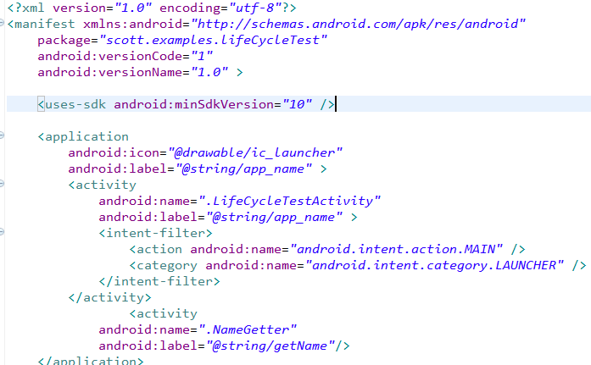
AndroidManifest.xml
All Activities that are part of application must be registered in Manifest
Specify Activity to start with
Notes:
This is the most common IntentFilter seen in Android applications. The action android.intent.action.MAIN indicates that this is the first activity that should be executed when starting this app. The category android.intent.category.LAUNCHER places this Activity in
the launcher window (the window that lists all the available apps).

Slide 24
What is used for what?
Entire lifetime: onCreate / onDestroy
Load UI
Could start and stop threads that should always be running
Visible lifetime: onStart / onStop
Access or release resources that influence UI
Foreground lifetime: onResume / onPause
Restore state and save state
Start and stop audio, video, animations

Slide 25
LifeCycleTest
overload these methods from Activity:
onCreate(), onStart(), onResume(), onPause(), onStop(), onRestart, onDestroy()
Use the Log class to log activity
methods: v, d, i, w, e
VERBOSE, DEBUG, INFO, WARN, ERROR
Create a TAG so we can filter

Slide 26
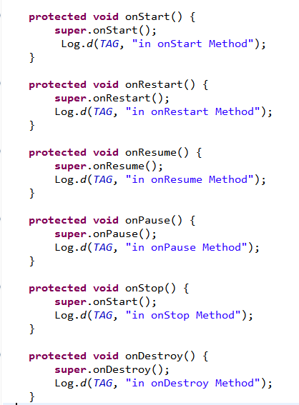
LifeCycleTest
Run the app and open the Logcat view.
Eclipse Window-> Show View -> Other -> Android -> Logcat or via DDMS

Slide 27
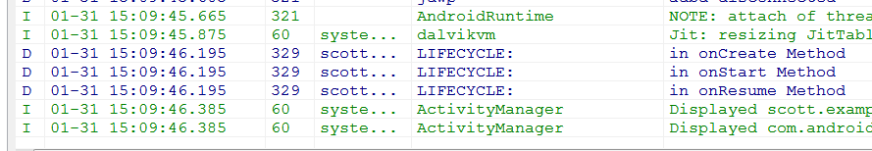
Logcat
After app started

Slide 28
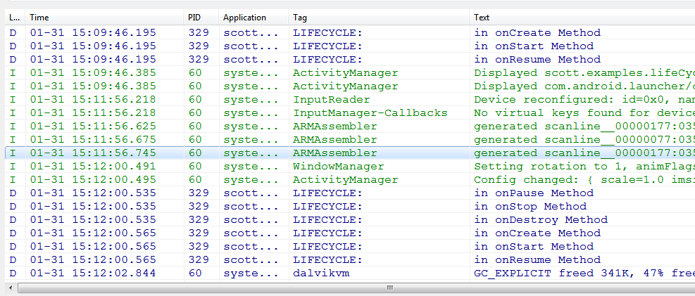
Logcat
Rotate emulator with CTRL+F-11

Slide 29
Pausing - onPause method
when activity paused you should
stop animations of other CPU intensive tasks
release resources such as broadcast receivers (app stops listening for broadcast info) and handles to sensors such as GPS device or handles to the camera
stop audio and video if appropriate

Slide 30
Stopping onStop()
Many scenarios cause activity to be stopped
Well behaved apps save progress and restart seamlessly
Activity stopped when:
user performs action in activity that starts another activity in the application
user opens Recent Apps window and starts a new application
user receives phone call
use onStop to release all resources and save information (persistence)

Slide 31
How to stop an Activity yourself?
Generally, don't worry about it!
"Note: In most cases, you should not explicitly finish an activity using these methods. As discussed in the following section about the activity lifecycle, the Android system manages the life of an activity for you, so you do not need to finish your own activities. Calling these methods could adversely affect the expected user experience and should only be used when you absolutely do not want the user to return to this instance of the activity."
methods: finish(), finishActivity()

Slide 32
Saving State
activities that are paused or stopped the state (instance vars) of the activity are retained
even if not in foreground
When activity destroyed the Activity object is destroyed
can save information via onSaveInstanceState method. Write data to Bundle, Bundle given back when restarted

Slide 33
Activity Destruction
app may be destroyed under normal circumstances
on its own by calling finish or user pressing the back button to navigate away from app
normal lifecycle methods handle this onPause(0) -> onStop() -> onDestroy
If the system must destroy the activity (to recover resources or on an orientation change) must be able to recreate Activity

Slide 34
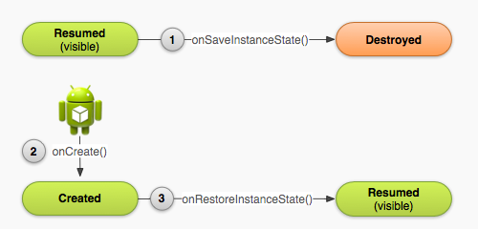
Activity Destruction

Slide 35
Activity Destruction
If Activity destroyed with potential to be recreate later
system calls the onSaveInstanceState (Bundle outState) method
Bundle is a data structure like a Map
String keys
put methods for primitives, arrays, Strings, Serializables (Java), and Parcels (android)

Slide 36
onSaveInstanceState onRestoreInstanceState()
systems write info about views to Bundle
other information must be added by programmer
example, board state for mastermind
When Activity recreated Bundle sent to onCreate and onRestoreInstanceState()
use either method to restore state data / instance variables

Slide 37
Starting You Own Activities
You will often start new Activities within your Activity
accomplish a task
get some data
Click Button to get name
on button click (look at xml)
create an intent
call startActivityForResult
override onActivityResult()
add new Activity to Manifest
add data to intent, setResult, finish
http://developer.android.com/guide/topics/fundamentals/activities.html#StartingAnActivity

Slide 38
Intent Demo
LifeCycle TestActivity
Intent holding constant
Name Getter
startActivityForResult()
Intent holding
Name
setResult()

Slide 39
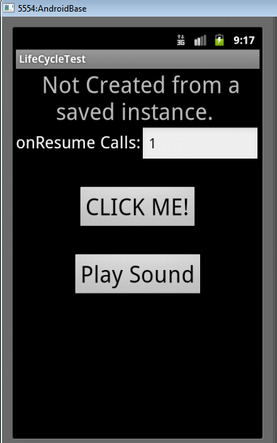
Playing Well (or not) With Others
The Play Sound button causes a MediaPlayer to be created and plays a sound
The Lifecycle app does not clean up after itself
If app destroyed MediaPlayer keeps playing!!

Slide 40
References
Android Introduction by Marko Gargenta, http://www.lecturemaker.com/2009/10/android-software-platform/
Android Dev Guide http://developer.android.com/guide/topics/fundamentals.html http://developer.android.com/guide/topics/fundamentals/activities.html
Pro Android by Hashimi & Komatineni (2009)
Frank McCown, Harding University

